Slide 1

Leveraging Machine Learning Approach to Setup Software Defined Network(SDN) Controller Rules During DDoS Attack
Presenter
Sajib Sen
4/30/18
1

Slide 2
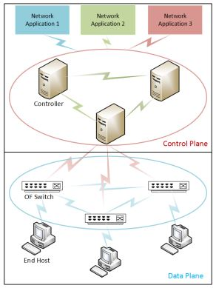
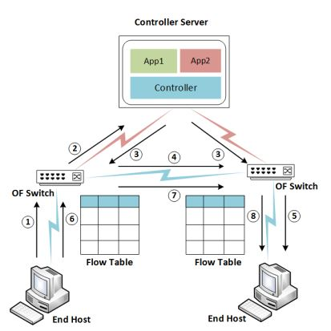
Introduction
Figure 1: Different planes and network application in SDN
Figure 2: Reactive traffic flow set-up in SDN

Slide 3
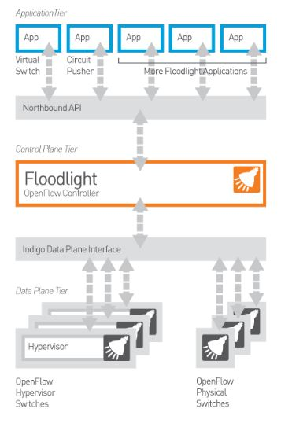
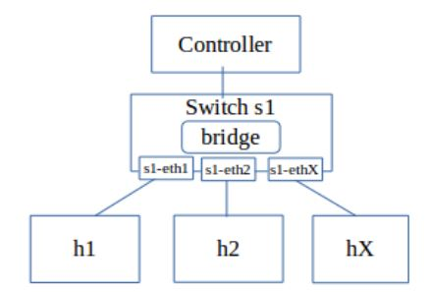
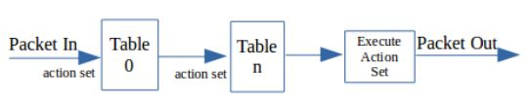
Introduction
Figure 3: OpenVSwitch architecture
Figure 4: Packet flow

Slide 4
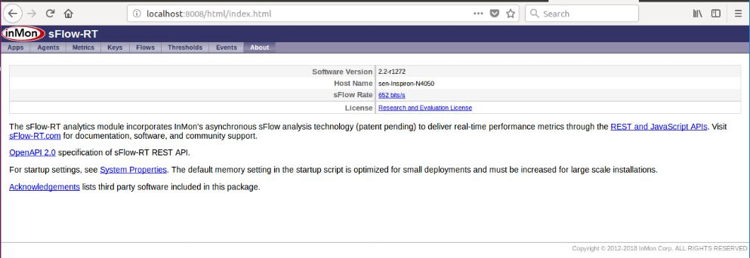
Introduction
Figure 5: sFlow-RT interface

Slide 5
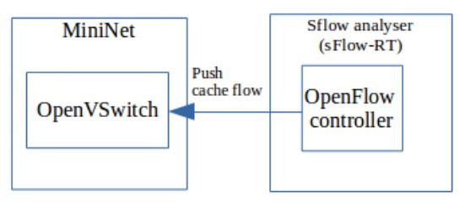
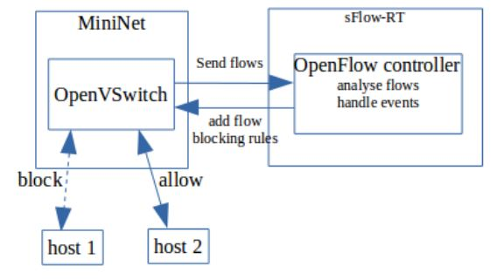
Introduction
Figure 6: Traffic monitoring
Figure 7: Event handling

Slide 6
Implementation:
To create a virtual network SDN topology:
sudo mn --controller=remote,ip=127.0.0.1,port=6653 --topo=single,3 --mac --switch ovsk
This tells Mininet to start up a 3-host, single-(openvSwitch-based)switch topology, set the MAC address of each host equal to its IP, and point to a remote controller which defaults to the localhost.

Slide 7
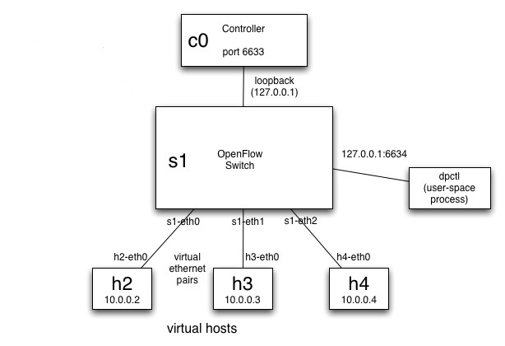
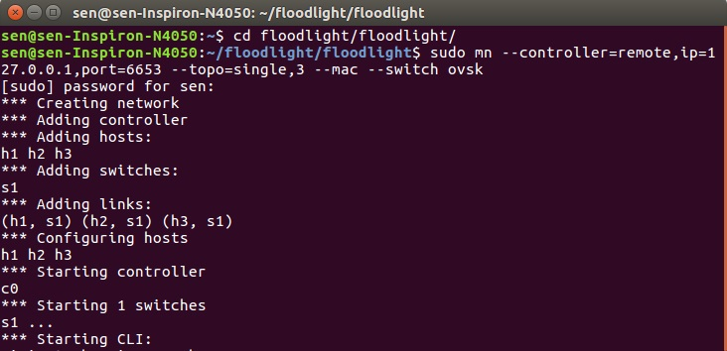
Implementation:
Figure 8: Setting of Virtual SDN

Slide 8
Flow rules set up in SDN controller:
# sudo ovs-ofctl add-flow s1 in_port=1,actions=output:2
# sudo ovs-ofctl add-flow s1 in_port=2,actions=output:1
This will forward packets coming at port 1 to port 2 and vice-verca.

Slide 9
Implementation:
To connect OpenVSwitch to sFlow-RT analyzer:
sudo ovs-vsctl -- --id=@sflow create sflow agent=eth0 target=\"127.0.0.1:6343\" sampling=10 polling=20 -- -- set bridge s1 sflow=@sflow
Here the OpenVSwitch has been connected to sFlow-RT with eth0 as agent and flow switch as s1.
To start: ./sFlow-rt/start.sh and to check the topology of mininet network in sFlow-RT need to visit
http://localhost:8008/metric/127.0.0.1/html
http://localhost:8080/ui/pages/index.html

Slide 10
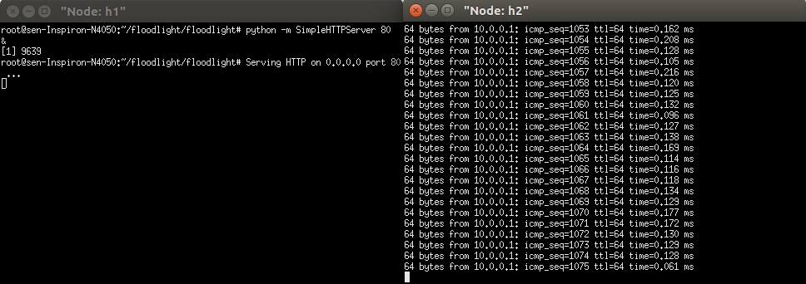
Implementation:
xterm h1 h2
on h1 terminal "python -m SimpleHTTPServer 80&
on h2 terminal "ping 10.0.0.1"
Figure 9: Ping request to node h1

Slide 11
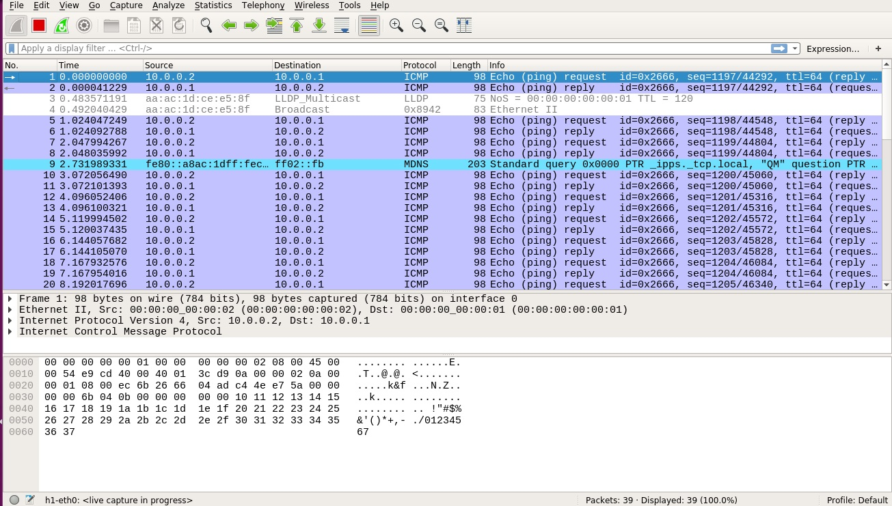
Implementation:
Figure 10: Network packet information in Wireshark

Slide 12
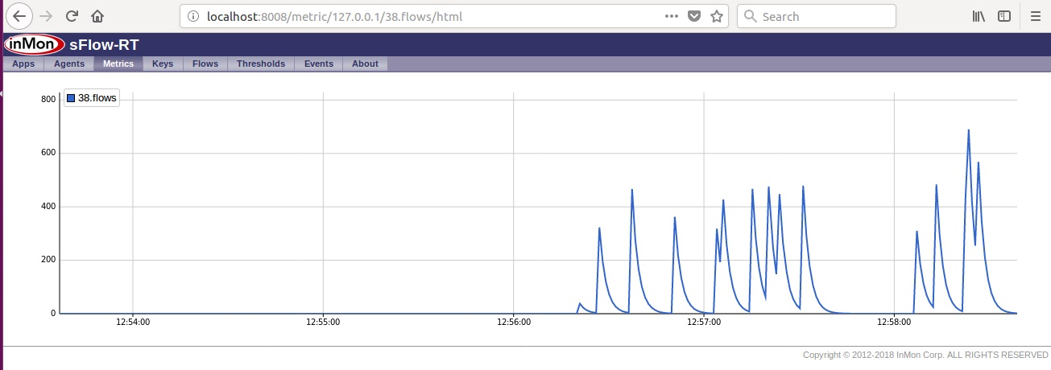
Implementation:
Figure 11 : Packet flow in s1-eth0 interface

Slide 13
Implementation:
Data Description:
No. | Features | Description
1 | Service | network service on the destination, e.g., http, telnet, etc.
2 | Header length | Length of Header data
3 | Flags | normal (0) or error(1) status of the connection
4 | TTL | Time to Live
5 | Protocol | type of the protocol, e.g. tcp, udp, etc.
6 | Data bytes | Bytes of data needed for certain protocol
7 | Epoch Time | Time to complete one epoch
8 | Reply Response Time | Time to give response
9 | Land | 1 if connection is from/to the same host/port; 0 otherwise

Slide 14
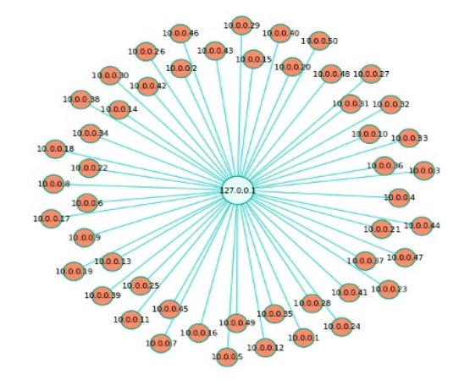
Implementation:
DDoS flood attack:
ping -f 10.0.0.1 command from different MiniNet hosts.
Besides to create flood attack manually, a payload had been created by python code using scapy library.
Figure 12: DDoS Attack

Slide 15
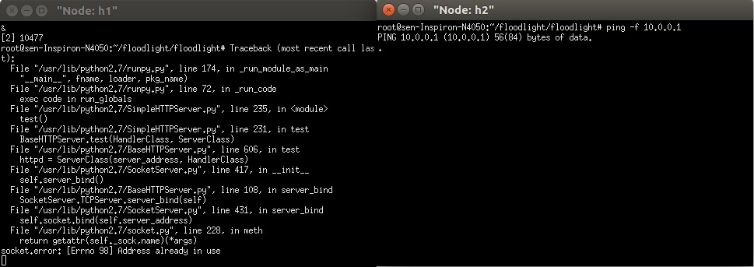
Implementation:
Figure 13: Ping flood attack to node h1

Slide 16
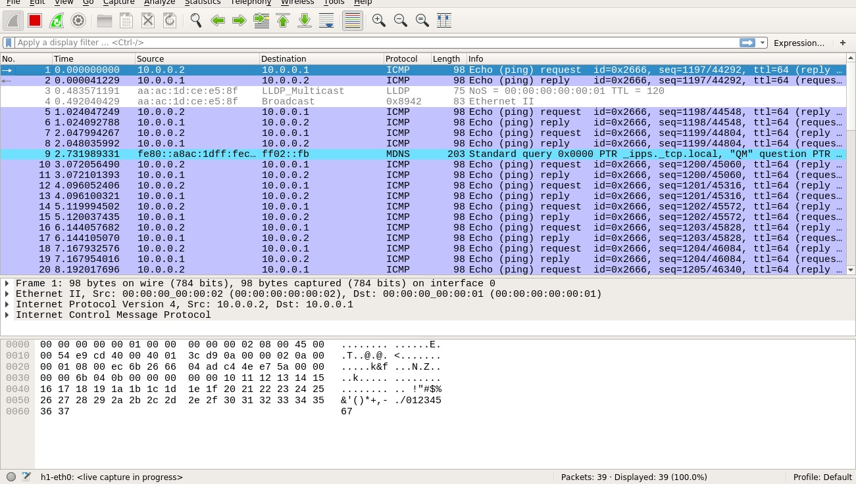
Implementation:
Figure 14: Ping flood packet data in wireshark

Slide 17
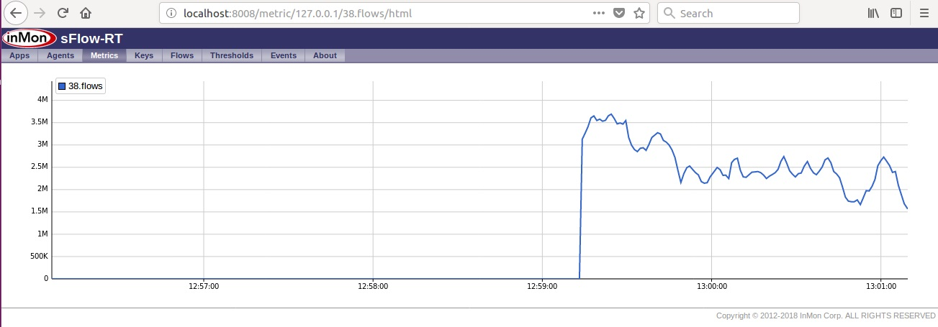
Implementation:
Figure 15: Dos attack in sFlow-RT

Slide 18
Result and Observation:
No | Techniques | Precision | Recall | F- Measure | ROC Area
1 | Bayes Net | 0.889 | 0.885 | 0.885 | 0.863
2 | Naïve Bayes | 0.731 | 0.705 | 0.693 | 0.707
3 | Multilayer Perceptron | 0.836 | 0.836 | 0.836 | 0.834
4 | Support Vector Machine(kernel=3) | 0.853 | 0.852 | 0.852 | 0.853
5 | AdaBoost (Decision Stump as weak classifier) | 0.934 | 0.934 | 0.934 | 0.887
6 | J48 decision tree | 0.903 | 0.902 | 0.901 | 0.880
7 | Random Forest | 0.837 | 0.836 | 0.836 | 0.899

Slide 19
Result and Observation

Slide 20
Limitation
Predefined rules have been setup during DoS attack
Only DoS attack has been implemented.

Slide 21
Conclusion
Virtual SDN testbed environment has been created
DoS attack performed on the network
Data collected for both normal and attack scenario.
Model trained and performance compare for different classifier

Slide 22
Thank you
4/30/18
22

